Slide 1


Slide 2
Assumptions
Dataset provided for the competition is assumed to be the single source of truth.
Null values are considered as missing values.
Insights provided are solely based on the graphs generated.

Slide 3

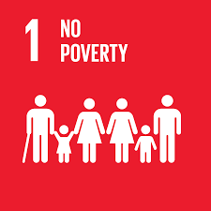

Slide 4
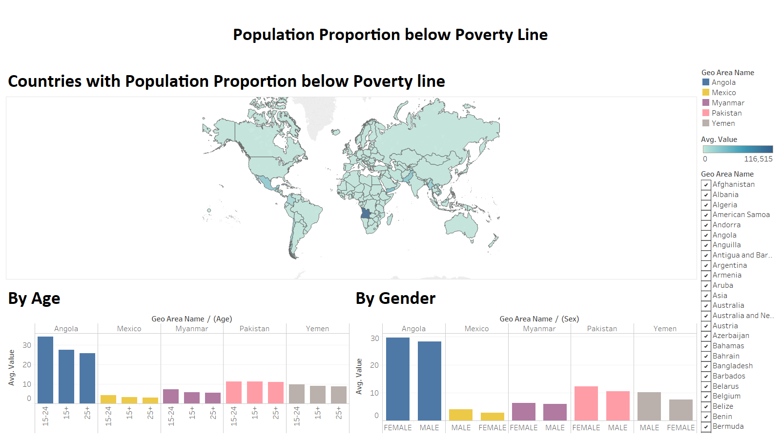
Angola is most prone to poverty

Slide 5
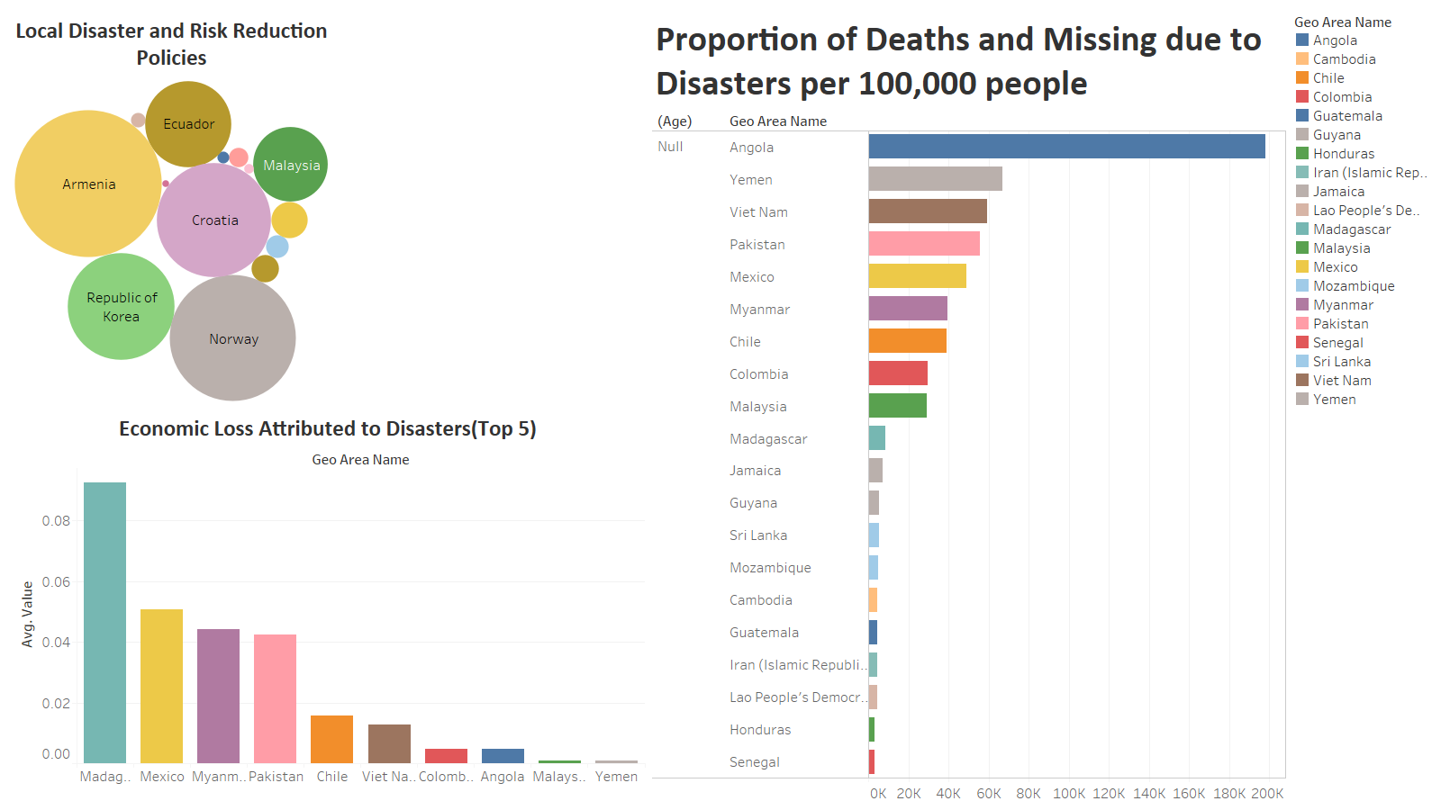

Slide 6
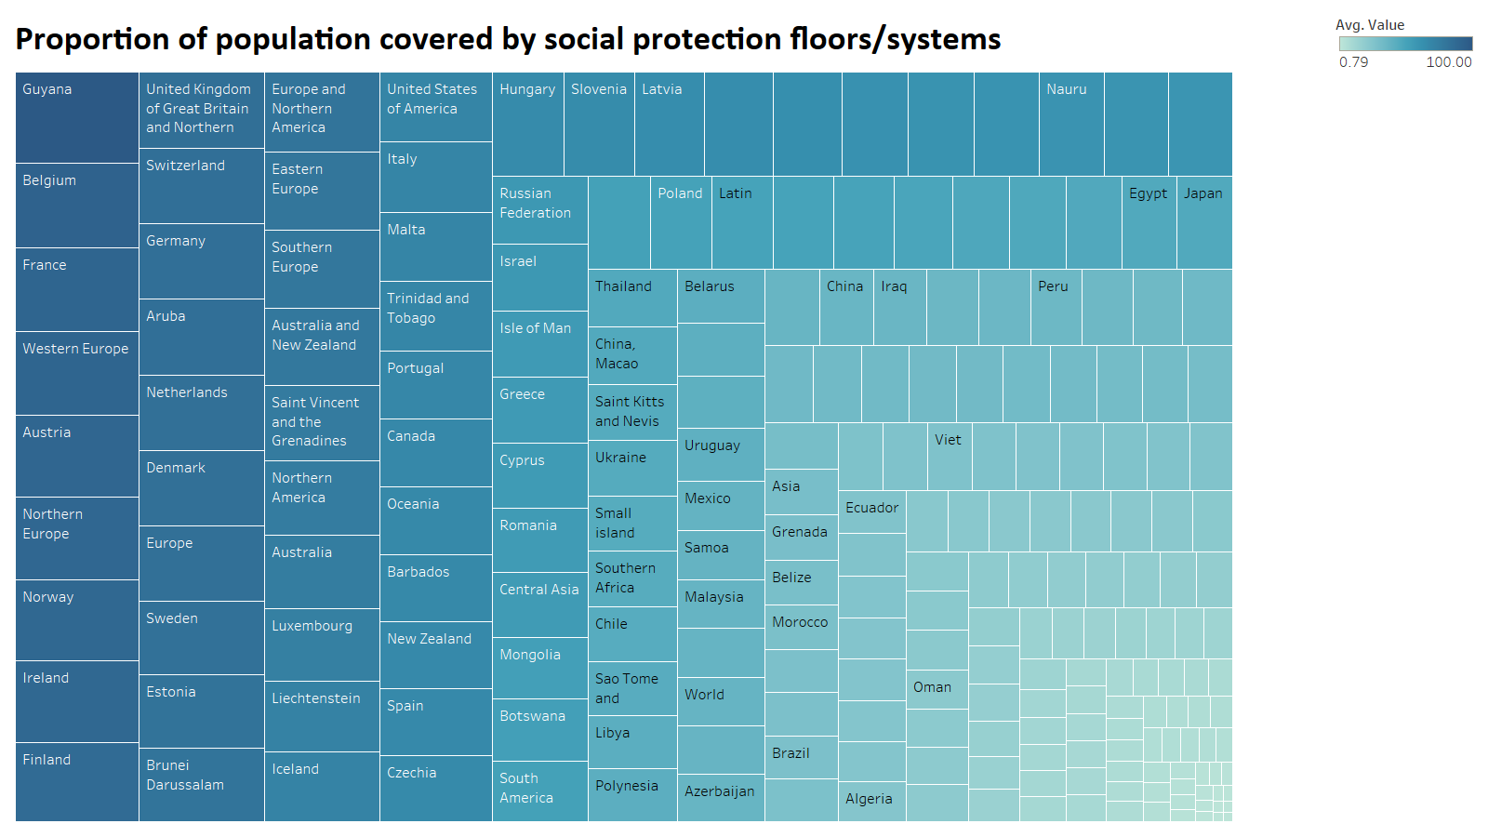
Guyana has a separate ministry for social protection aimed at improving the social protection of its citizens.

Slide 7
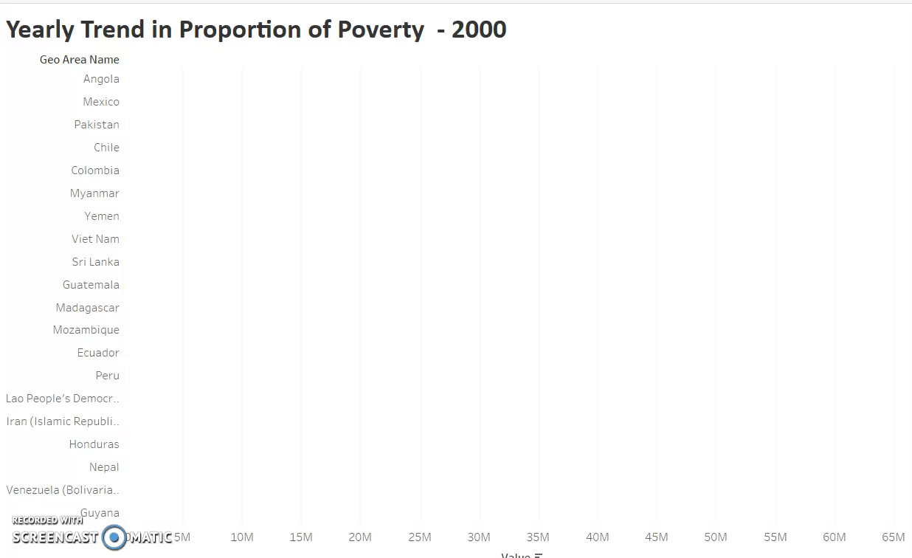

Slide 8
Insights
There is a direct correlation between this goal and the socio-econo-political conditions of the nations.
The under-developed nations are not able to meet the UN sustainability goals.
Disasters have been playing a major roles in countries like Angola.
Disasters hinder the economic growth of the country and thereby stopping them from improving their journey towards attaining their goal.
Two earthquakes in Chile on year 2007 and floods in Pakistan for year 2012.
Prolonged drought in Angola from year 2012-2014

Slide 9


Slide 10
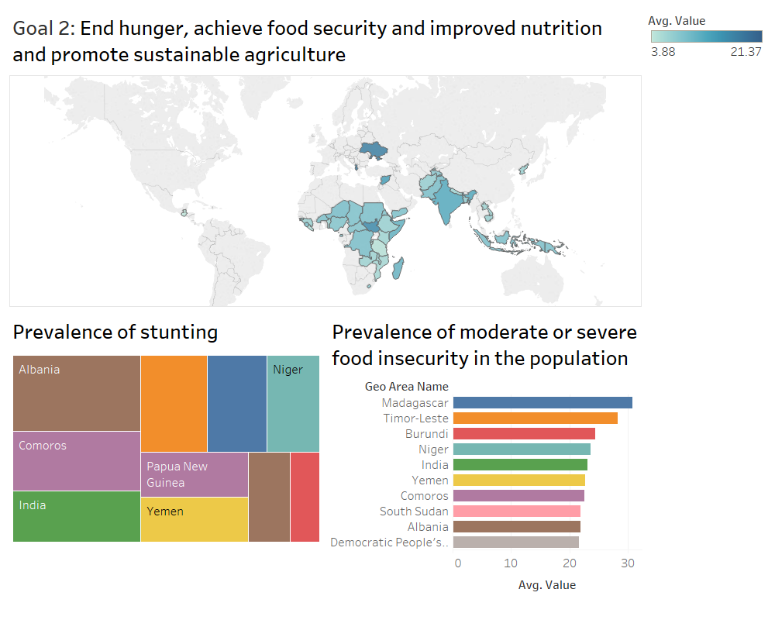

Slide 11
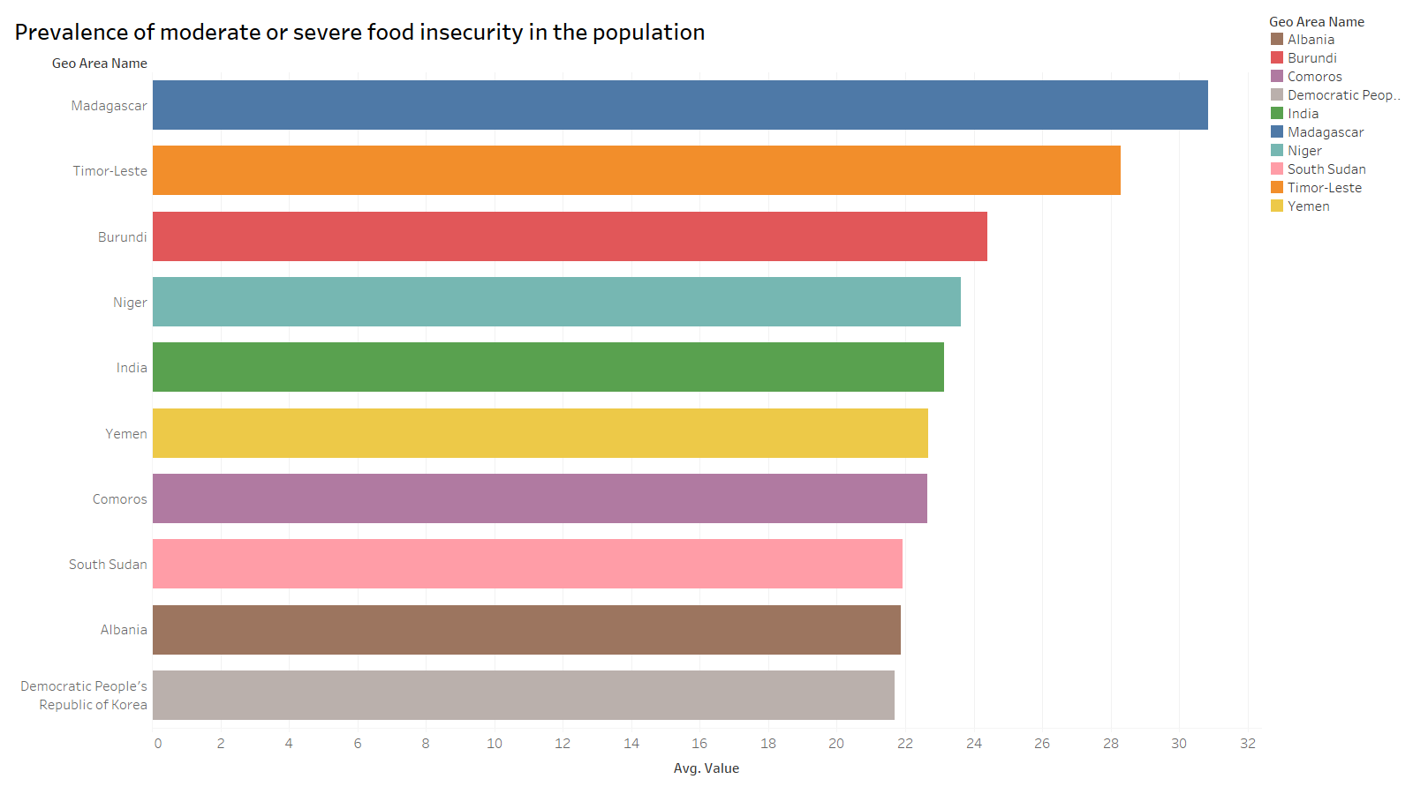

Slide 12
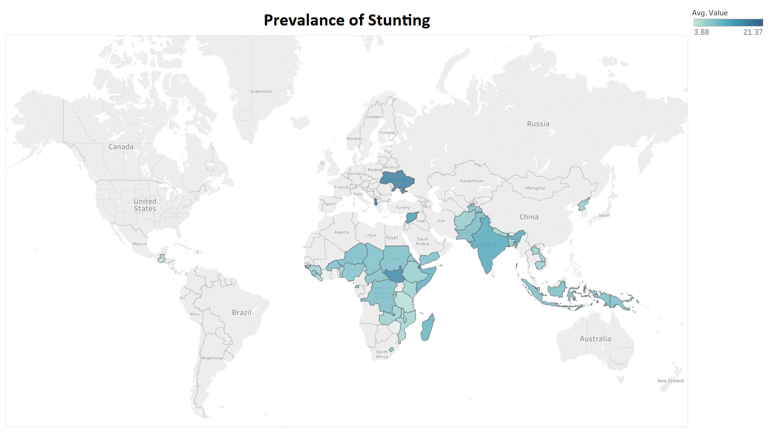

Slide 13
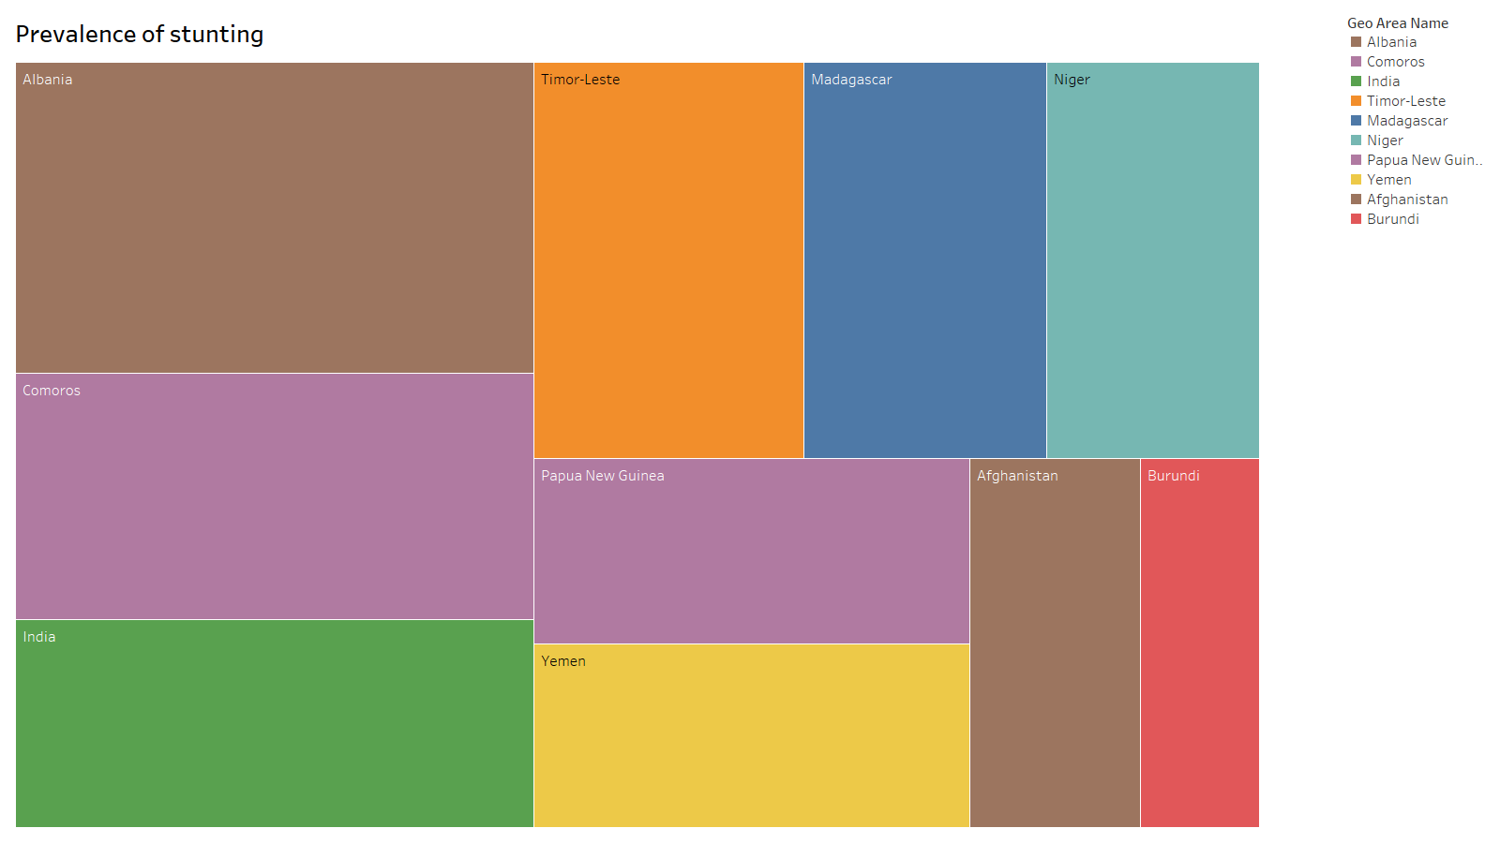
Albania being a very small country in area still face issues in overcoming child malnutrition problem.

Slide 14
Insights
Hunger and stunting is mostly prevalent in African and South Asian Countries.
There are few exceptions like Albania and Ukraine. They are European countries but they stay on top of the list.
India accounts nearly 20% of the global population is present in the list.

Slide 15


